Slide 1
Twitter Mood Monitor
Team QRCode Ricky Madden &
Quinn McTiernan

Slide 2
Overview
Twitter Mood Monitor is a web application programmed to detect the current mood of cities based on the tweets being sent.
Our database is written in SqLite3
our client side is hosted in a Node.js server which accesses the database

Slide 3
Database Specifics
Our TweetParsingEngine.py updates the database when new tweet information is retrieved
Mood data is determined by the presence of happy or unhappy emoticons
The database’s cache is cleared once a day, ensuring the mood data is representative of the last 24 hours

Slide 4
Mood Algorithm
These regex objects look for two things each. Firstly an emoticon such as =) then an emoticon such as (-= to capture both directions.
An emoticon is defined as a set of mouth characters, an optional nose character (or tears for the sad regex), and a mouth. It must start with either whitespace or the “beginning of a string” character and end with either a whitespace or “end of line” character

Slide 5
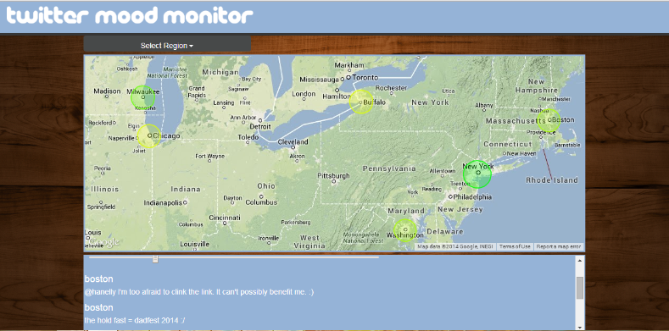
Web Application Specifics
Upon navigation, the web application presents the user with a description and prompts the user to select a location from a drop down box.
Upon location selection, the web application will navigate to the map page and display the tweet information

Slide 6
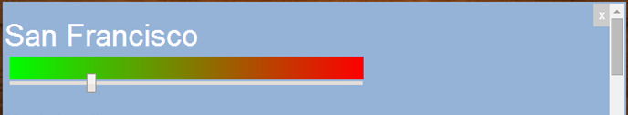
Viewing Mood Data
Mood is determined as the percent of happy emoticons.
Mood is calculated as totalHappy / totalParsed
Each mood range represents 10% happiness
A few sample tweets are visible below the mood data which show the thoughts of people in the selected city

Slide 7
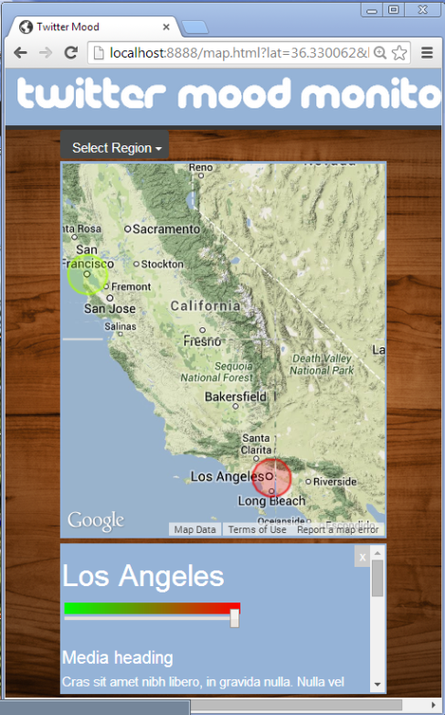
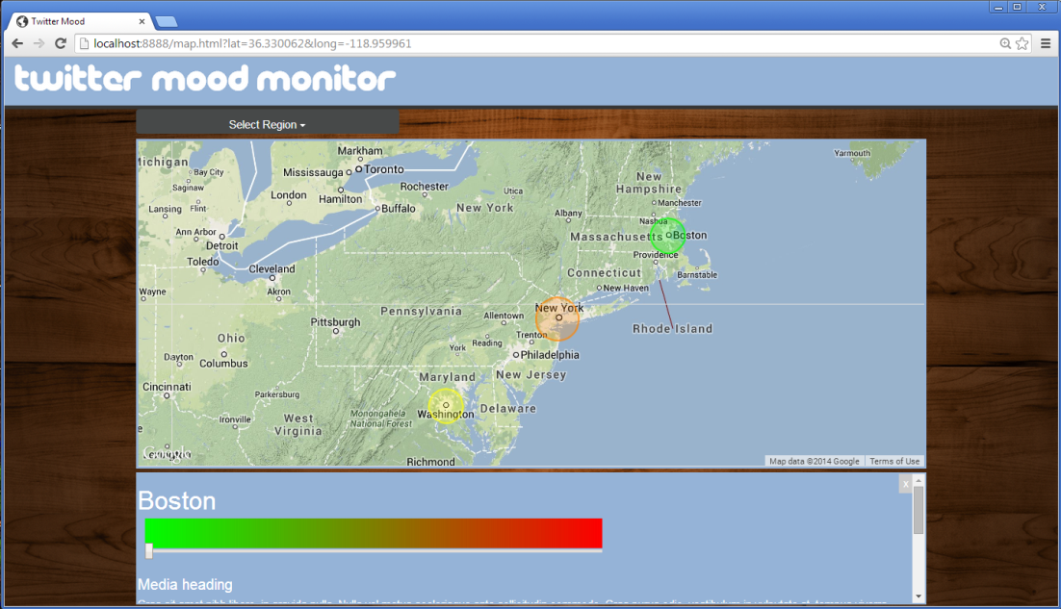
Responsive Application
The web application is designed to respond to different screen widths
This application displays correctly on both a monitor and a mobile device

